Slide 1
Smart Energy Management System

Slide 2
Aim & Objectives
1. The Main Aim of Smart Energy Management System (EMS) in Java program is to optimize energy usage.
2. This can be used to track energy usage, set target energy usage, and take necessary actions to ensure that energy usage is within acceptable limits.
3. This can help to reduce energy costs.
4. Another main objective is to improve energy efficiency.
5. This Smart Energy Management System can help to reduce greenhouse gas emissions.
6. By this we can save the unrenewable resources also.

Slide 3
Introduction
The EMS can be used to track energy usage from a variety of sources, including:
Electricity meters, Water meters , Lighting systems etc.
How it works
1. The SEMS works by collecting energy usage data from various sources.
2. The SEMS then uses this data to calculate the current energy usage.
3 .The SEMS then compares the current energy usage to the target energy usage.
4. If the current energy usage is above or below the target energy usage, the SEMS will take necessary actions to ensure that energy usage is within acceptable limits.

Slide 4
5. The actions to ensure that energy usage is within acceptable limits, including: a. Turning off non-essential devices. b. Adjusting thermostat settings. c. Closing blinds or curtains. d. Unplugging appliances.
6. The SEMS can also be used to generate reports on energy usage.
7. These reports can be used to track energy usage over time, identify areas where energy usage can be reduced, and make informed decisions about energy management.
8. For this we need to include this with the either Arduino boards or other IOT related devices.

Slide 5
System requirements:
Software Requirements
A | Programming Language | Java
B | Operating System | Windows 8 and above
C | Integrated Development Environment (IDE) | Visual Studio
Hardware Requirements
A | RAM | 4GB and Above
B | Processor | I3 and above

Slide 6
Modules
The EMS is implemented in Java.
The EMS uses the following libraries:
Java.util.Scanner
Java.time.LocalTime
The EMS is designed to be easy to use and can be customized to meet the needs of any organization.
Methods defined in the classes SmartThermostat and SmartLightingSystem.

Slide 7
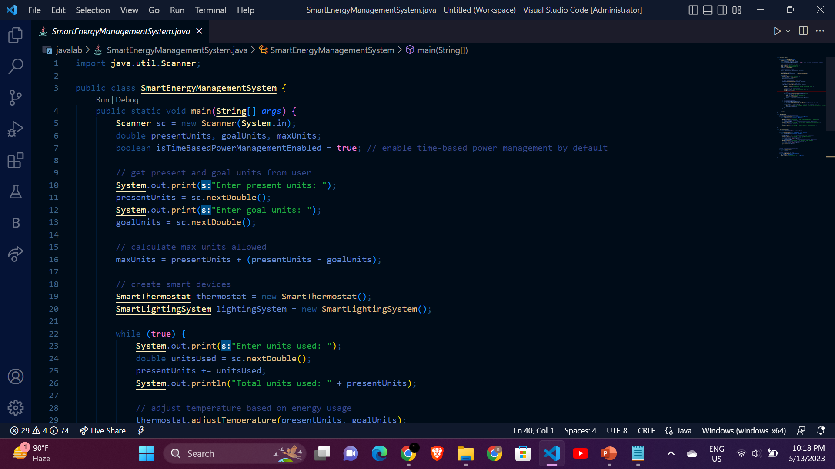
Code:

Slide 8
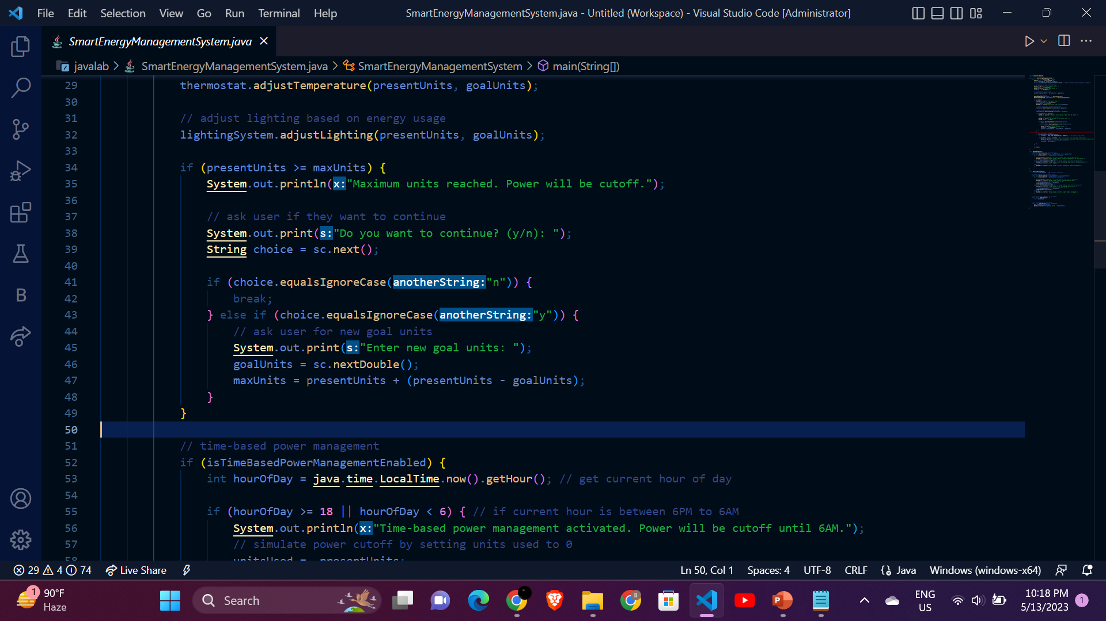

Slide 9
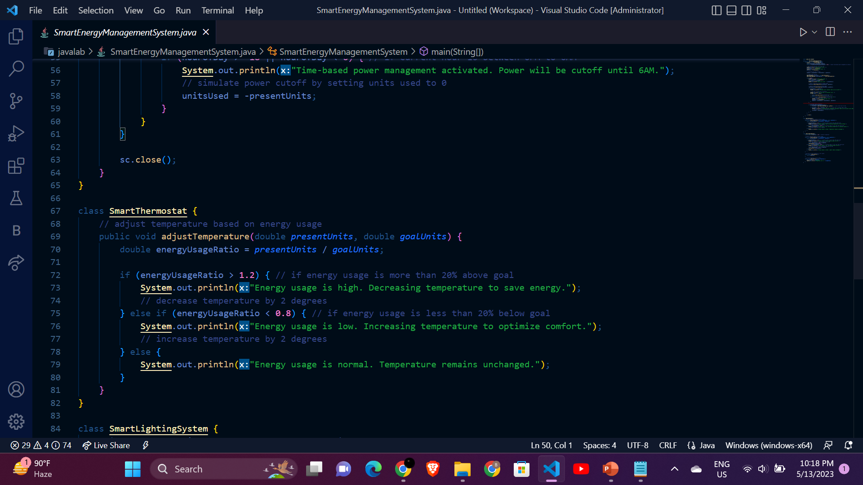

Slide 10
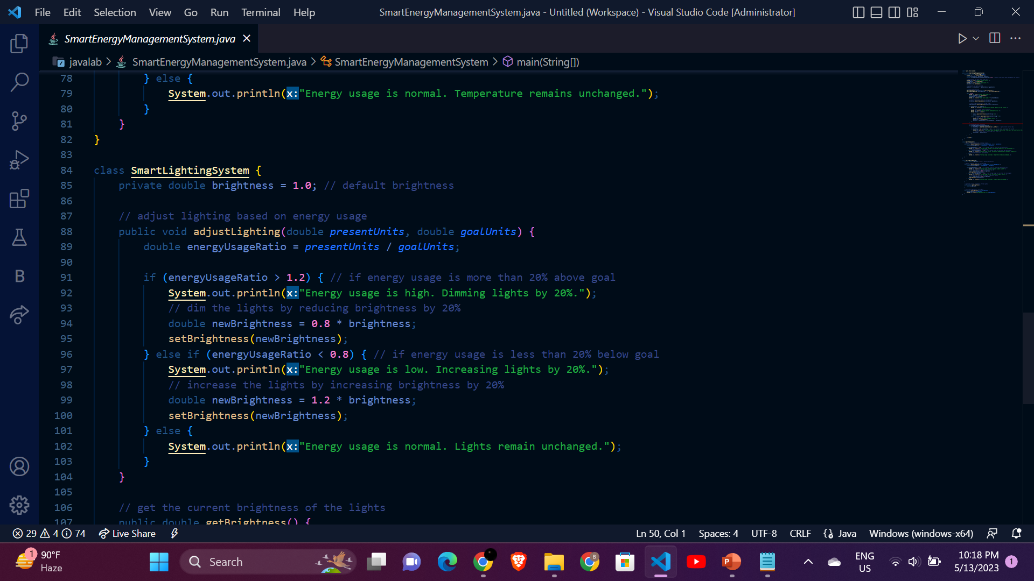
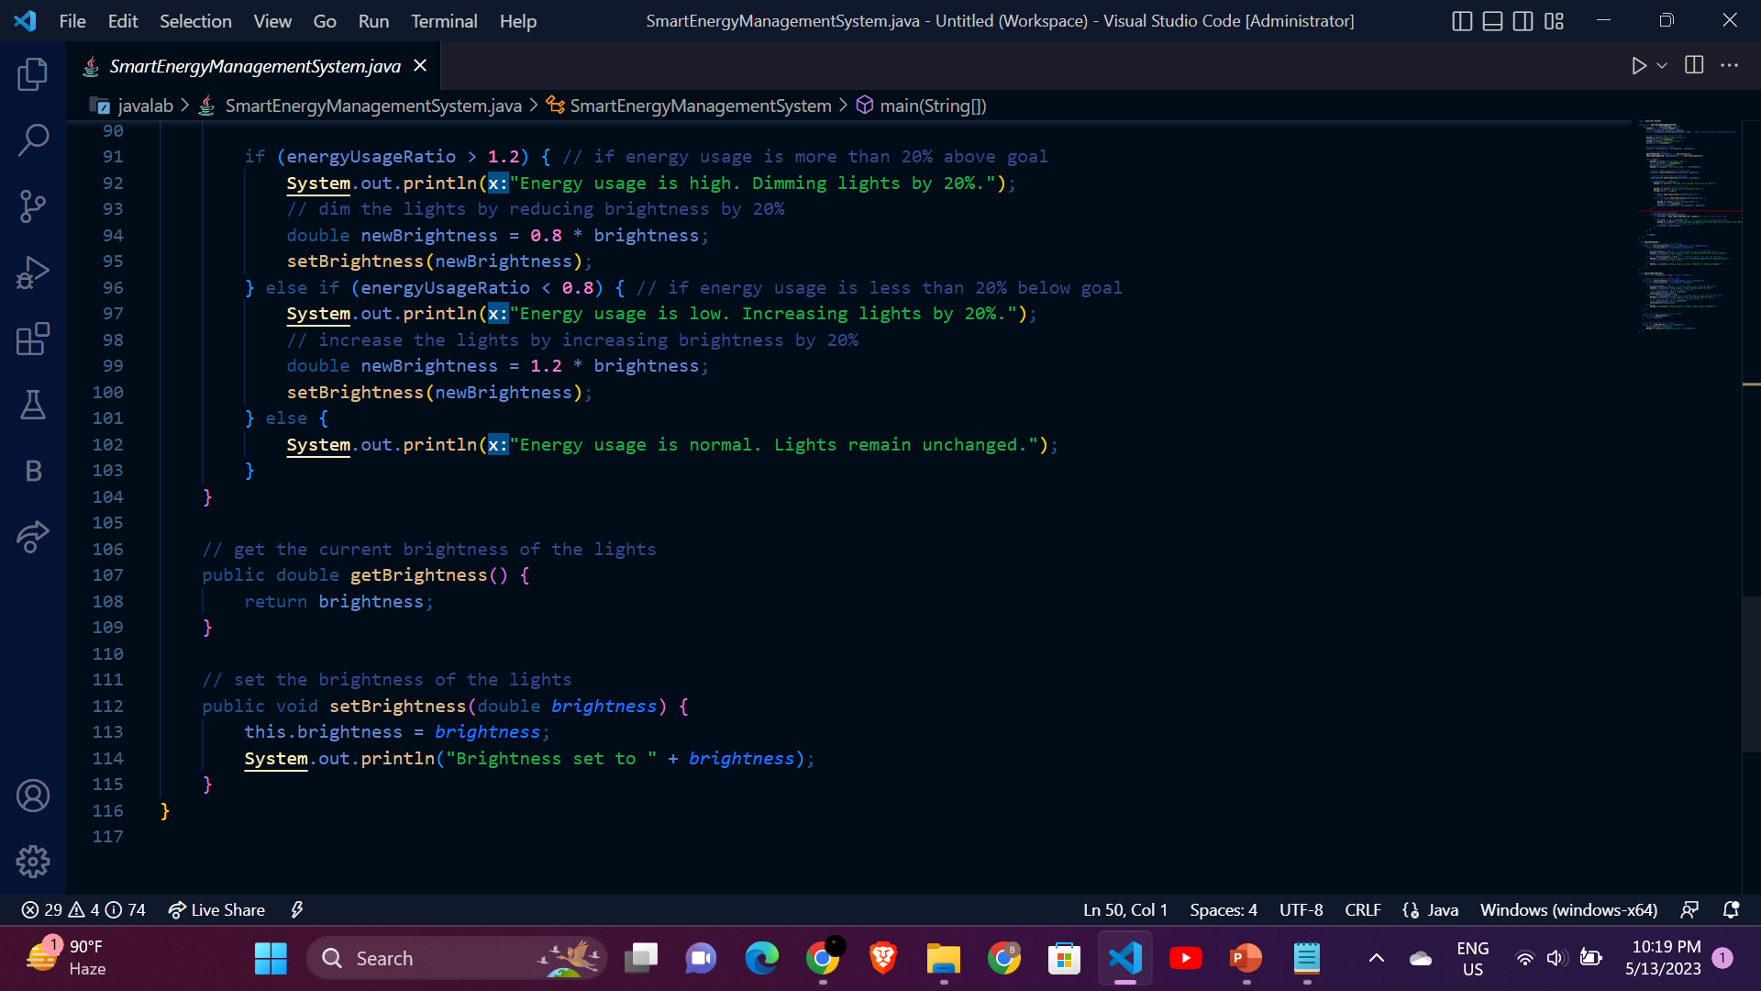

Slide 11
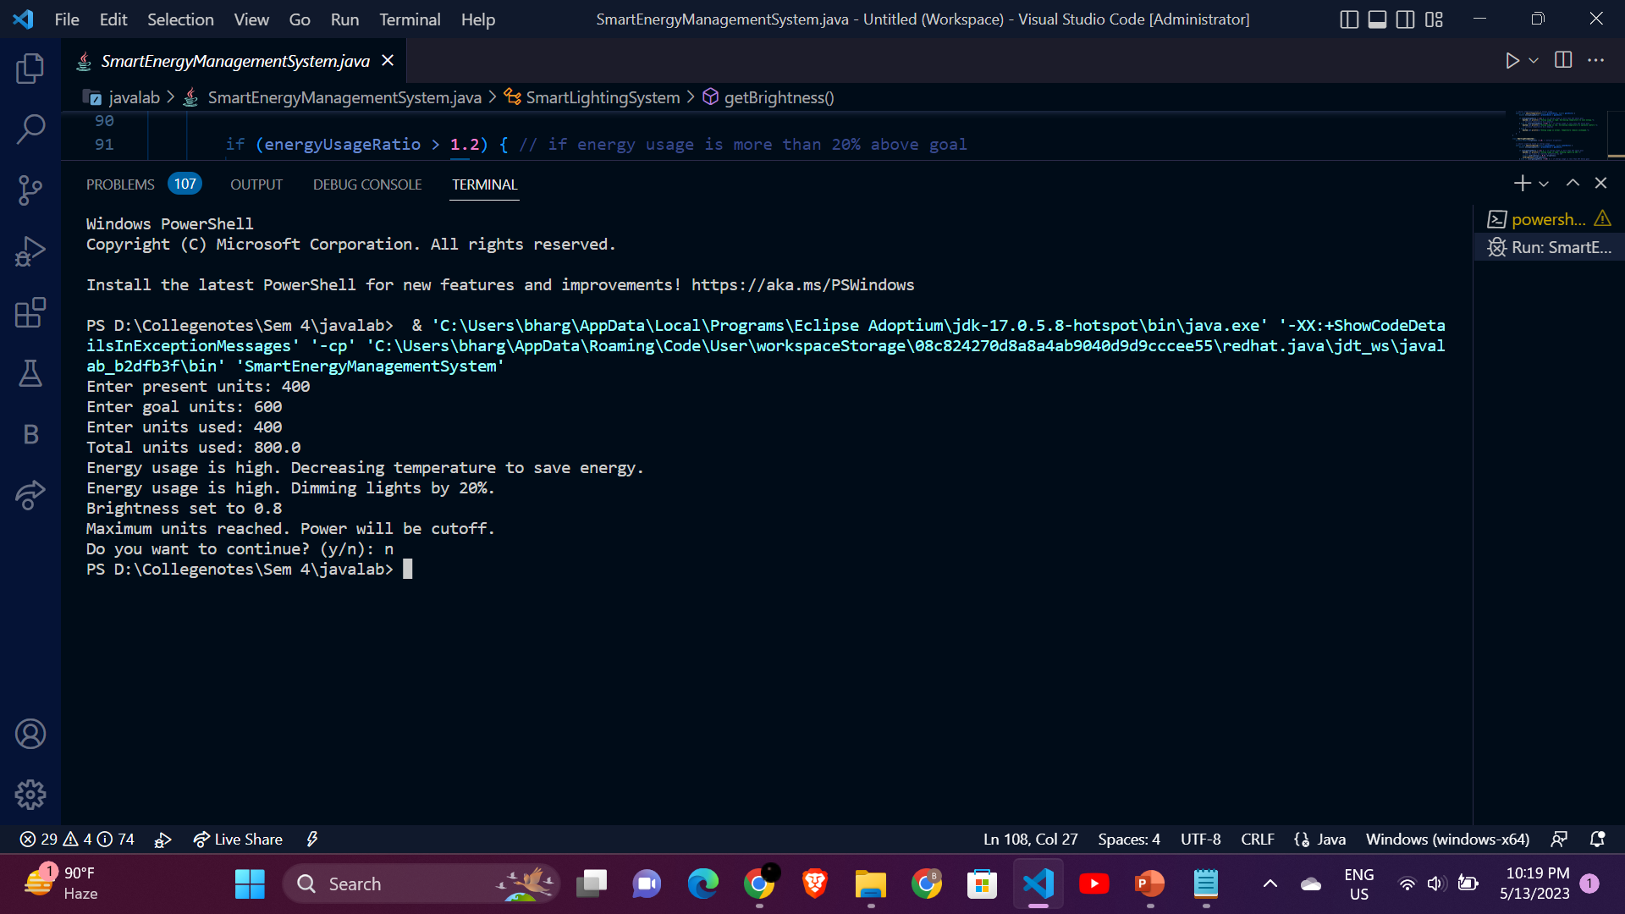
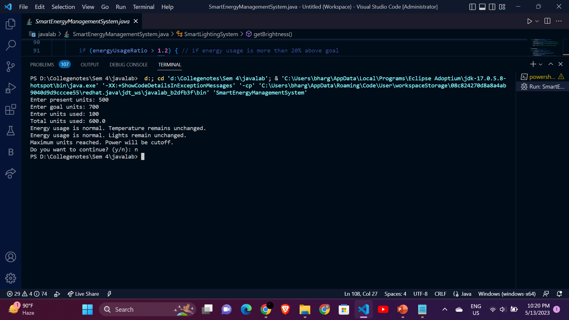
output:

Slide 12
conclusion:
1.The SEMS is a powerful tool that can help to optimize energy usage.
2. The SEMS is easy to use and can be customized to meet the needs of any organization.
3. If you are looking for a way to reduce energy costs, improve energy efficiency, and reduce greenhouse gas emissions, then the SEMS is a great option.

